Slide 1
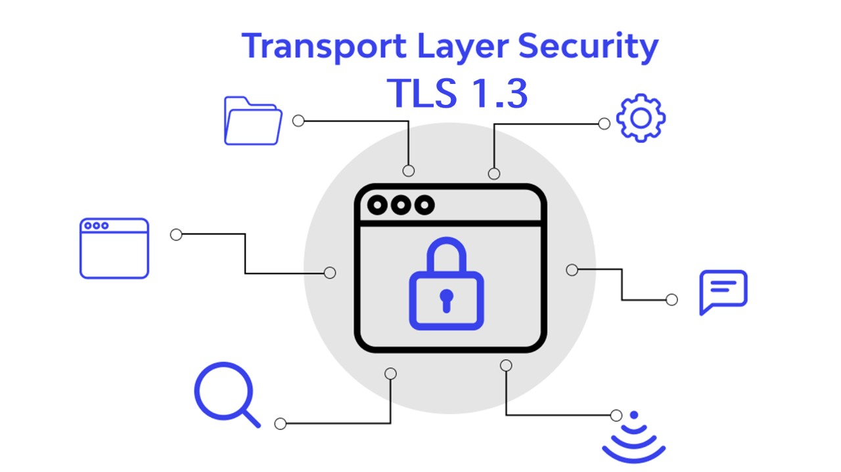
Transport Layer Security

Slide 2
TLS is an Internet standard that evolved from a commercial protocol known as Secure Sockets Layer (SSL).
TLS is designed to make use of TCP to provide a reliable end-to-end secure service between web server and web applications .
Implemented at the Transport Layer.
Ex: Login credentials, emails, web browsers data
TLS vs SSL
More robust encryption algorithms are used in TLS compared to SSL.
Use of HMAC for Authentication , provides more security
SSL can send only 1 alert message whereas TLS sends more than 2 messages for both the parties

Slide 3
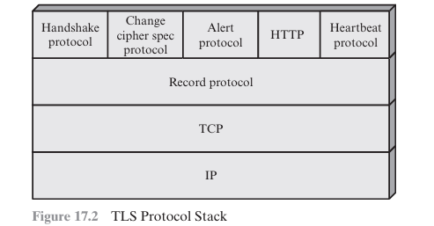
TLS Architecture :
TLS is not a single protocol but rather two layers of protocols.
TLS Record Protocol
Handshake

Slide 4
Two important concepts of TLS :
■ Connection: For TLS, such connections are peer-to peer relationships. The connections are transient. Every connection is associated with one session.
■ Session: A TLS session is an association between a client and a server. Sessions are created by the Handshake Protocol. Sessions define a set of cryptographic security parameters, which can be shared among multiple connections.
Main Services of TLS
Authentication – HMAC
Encryption – Symmetric and Assymmetric keys
Integrity – No modification of message

Slide 5
Here are real-life examples for each:
Authentication: -
-> Username and password: Logging into your email account or social media profile.
-> Biometric authentication: Unlocking your smartphone with a fingerprint or face scan. 2.Encryption: -
-> SSL/TLS encryption: When you make a purchase online, your credit card information is encrypted during the transaction.
-> End-to-end encryption: Messaging someone on WhatsApp or Signal, where only you and the recipient can read the messages.
3. Integrity: -
-> Hash functions: Verifying the integrity of downloaded files by comparing their hash value with the one provided by the source.
-> Digital signatures: Signing a document digitally to ensure its integrity and authenticity, commonly used in legal contracts.

Slide 6
TLS RECORD PROTOCOL
The TLS Record Protocol provides two services for TLS connections:
■ Confidentiality: The Handshake Protocol defines a shared secret key that is used for conventional encryption of TLS payloads.
■ Message Integrity: The Handshake Protocol also defines a shared secret key that is used to form a message authentication code (MAC).
Uses Symmetric Key for session key generation.

Slide 7
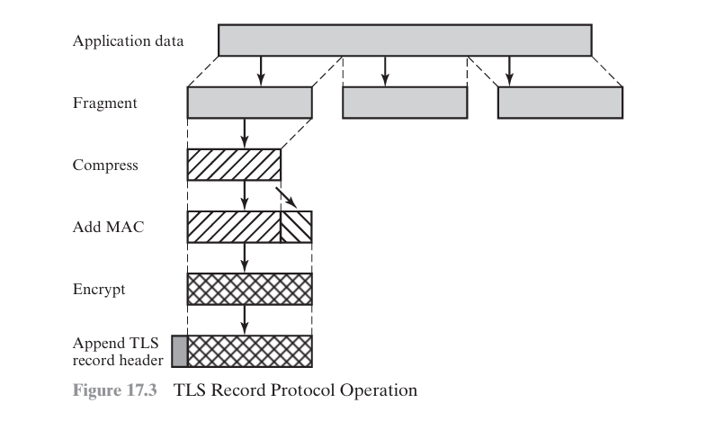

Slide 8
HMAC(M) = H[(K+ ⊕opad) || H[(K+ ⊕ipad) || M]]
Where,
H = embedded hash function (for TLS, either MD5 or SHA-1)
M =message input to HMAC
K+ =secret key padded with zeros on the left so that the result is equal to the block length of the hash code (for MD5 and SHA-1, block length = 512 bits)
ipad = 00110110 (36 in hexadecimal) repeated 64 times (512 bits)
opad = 01011100 (5C in hexadecimal) repeated 64 times (512 bits)
For TLS, the MAC calculation encompasses the fields indicated in the following expression:
HMAC_hash(MAC_write_secret, seq_num || TLSCompressed.type || TLSCompressed.version || TLSCompressed.length || TLSCompressed.fragment

Slide 9
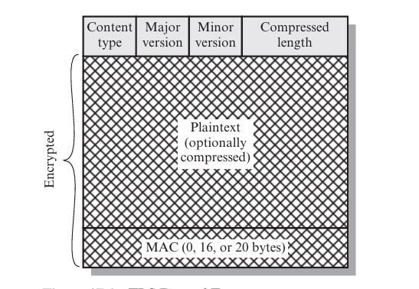
Change Cipher PROTOCOL
The Change Cipher Spec Protocol is one of the four TLS-specific protocols that use the TLS Record Protocol, and it is the simplest.
This protocol consists of a single message, which consists of a single byte with the value 1.
The sole purpose of this message is to cause the pending state to be copied into the current state, which updates the cipher suite to be used on this connection.

Slide 10
Header has 4 fields :
Content Type (8 bits): The higher-layer protocol used to process the enclosed fragment. (Type of Message being transmitted)
Major Version (8 bits): Indicates major version of TLS in use. For TLSv2, the value is 3.
Minor Version (8 bits): Indicates minor version in use. For TLSv2, the value is 1
Compressed Length (16 bits): The length in bytes of the plaintext fragment (or compressed fragment if compression is used).

Slide 11
THANK YOU
J.YASASCHANDRA
21131A05D5

